Slide 1
Defensive Lineman Analysis
Trevor Kniaz and Zach Ketzlach

Slide 2
Table of Contents
Clustering Methodology
Calculating “Expected EPA”
Question 1: Which is the most valuable defensive line position?
Question 2: What is the nature of the distribution of talent between the defensive line positions, as you define them?
Question 3: In which in-game or roster construction scenarios would the answer to question 1 change?
Additional Information
Data Dictionary
Assumptions

Slide 3
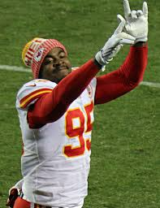
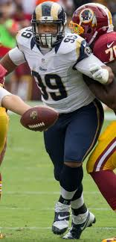
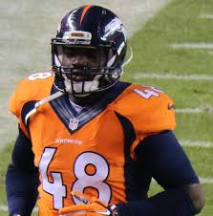
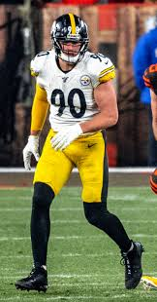
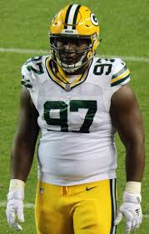
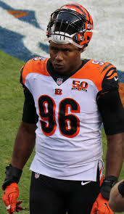
Introduction
Defining defensive line positioning has become something of a controversial topic. Last week Shaq Barrett was franchise tagged as a linebacker rather than defensive lineman, costing him close to $2 million for the upcoming season.
We propose a new methodology of categorizing defensive lineman that more accurately reflects the way they are used on the field.

Slide 4
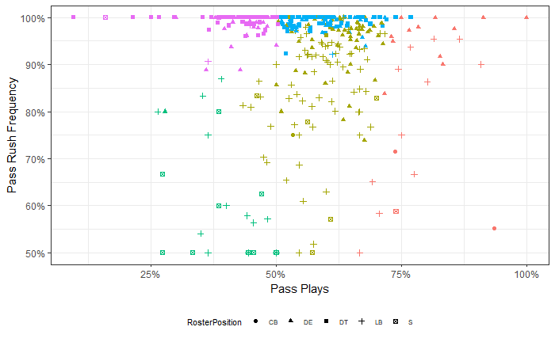
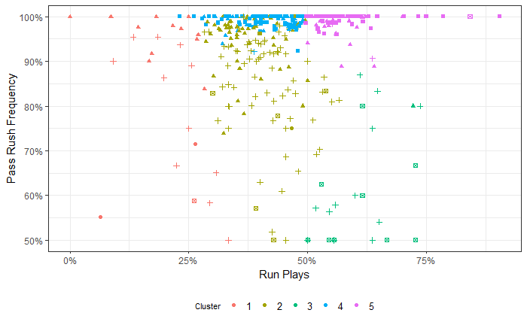
Clustering Methodology
We defined positions by using a princicple components clustering technique.
We used Technique, Percent_RunPlays, Percent_PassPlays, PercentRush_On_Pass to determine which group each player should fit into. We ended up with five positions: Run Stopper, Down Lineman, EDGE Rusher, EDGE Cover, and Secondary...
Aaron Donald
Lawrence Guy
Matt Judon
Vonn Bell
Demario Davis
Percent Pass Plays
Percent Run Plays
EDGE Cover (Red )= Mix of DE and LB who mostly play the pass and drop into coverage; EDGE Rusher (Gold)= Mix of DE and LB who are on field for both run and pass plays who mostly rush but also cover; Run Stopper (Pink)= typically DT who mostly play the run; Down Lineman (Light Blue)= Mix of DT and DE who are on field for both run and pass plays and always rush; Secondary (Green)= Secondary Players or LB in coverage

Slide 5
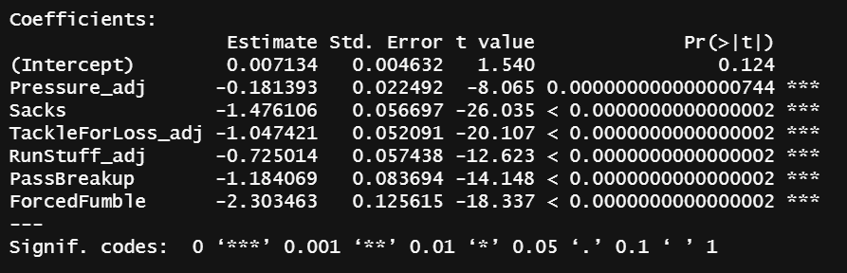
Calculating Expected EPA
To measure performance first, we took the average of each player's EPA to get an overall EPA. We quickly noticed that EPA itself is not a representative metric for an individual d-lineman, as it is mostly determined by overall team success.
We ran a linear regression on each play for each player, using EPA as the dependent variable and Pressure_adj, Sacks, TackleForLoss_adj, RunStuff_adj, PassBreakup, ForcedFumble as dependent variables.
This allowed us to measure individual player performance while minimizing the importance of overall team success. Using the weighting on each of the metrics we used, we were able to calculate Exp_EPA for each player on each play. From here we took the average to determine best performance in the last 8 games of the 2019 regular season. Below are the weightings for each individual metric…

Slide 6
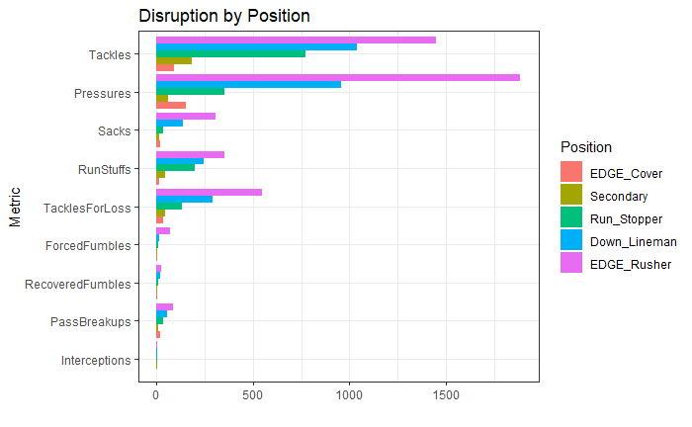
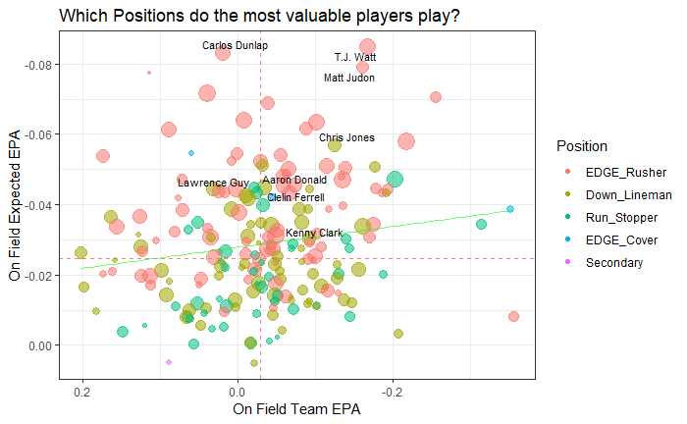
Question 1: Which is the most valuable defensive line position?
EDGE Rushers lead all position groups in Tackles, Pressures, Sacks, Run Stuffs, Tackles for Loss, Forced Fumbles, Recovered Fumbles, Pass Breakups, and Interceptions. Consequently, EDGE Rushers are the leaders in Expected EPA.

Slide 7
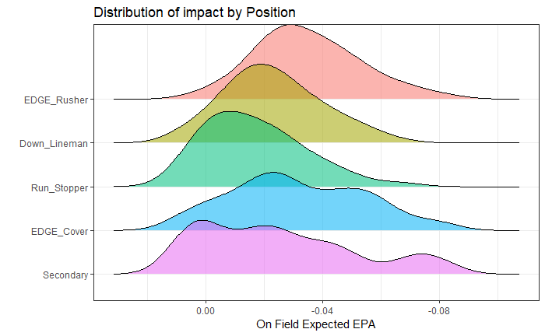
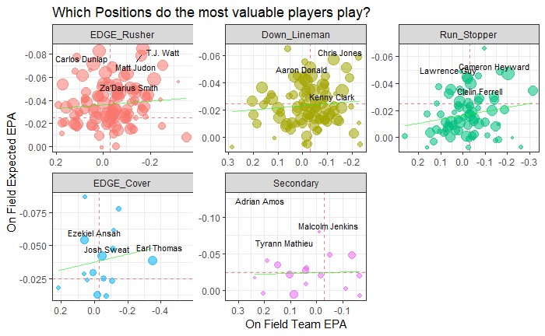
Question 2: What is the nature of the distribution of talent between the defensive line positions, as you define them?
EDGE Rushers have the highest distribution of top-end talent of any of the position groups. Secondary has the lowest distribution of top-end talent among any of these position groups in terms of value on the defensive line value. EDGE Cover and Secondary players have considerably wider distribution of performance than the other position groups.

Slide 8
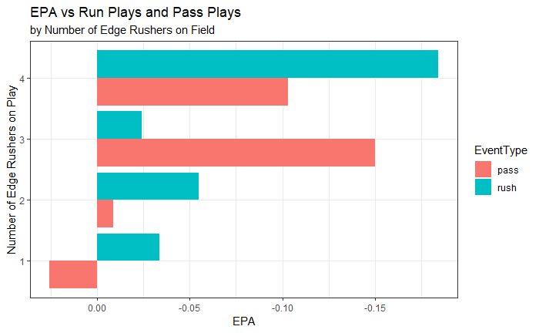
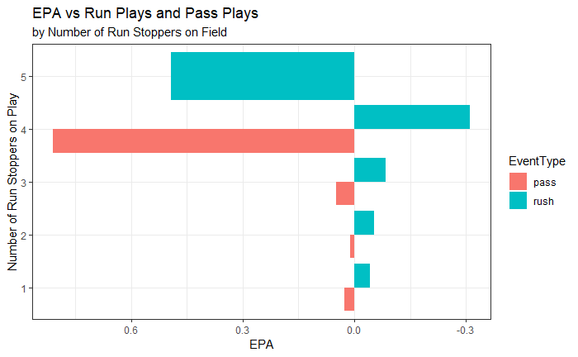
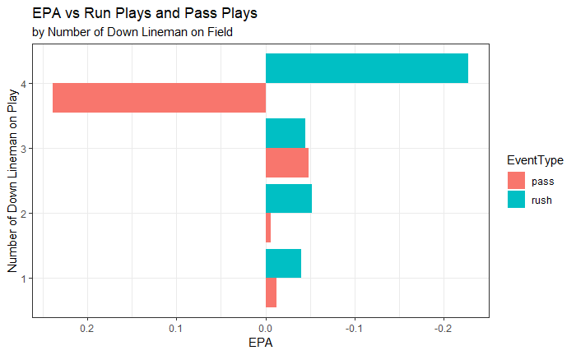
Question 3: Not all situations are created equal. In which in-game or roster construction scenarios would the answer to Question 1 change?
Having three or more EDGE Rushers on the field against the pass improves EPA
Against the run, having more Run Stoppers on the field improves EPA (under 100 plays with four or more Run Stoppers)
EPA against the run is steady with 1-3 Down Lineman on the field. But against the pass EPA improves with 3 Down Lineman (Under 100 Plays with four or more Down Lineman)

Slide 9
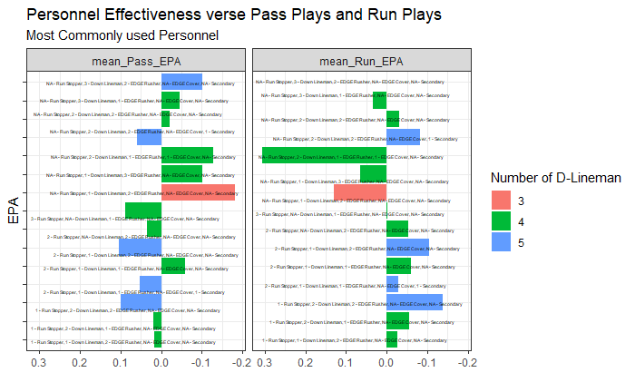
Question 3: Not all situations are created equal. In which in-game or roster construction scenarios would the answer to Question 1 change?
Among the most used personnel groupings in the NFL, only a couple are successful against the Run and the Pass.
Both include four lineman.
Neither includes an EDGE Cover or a Secondary player
Both include at least one Run Stopper and one EDGE Rusher

Slide 10
Data Dictionary
Tackles= SoloTackles + (AssistedTackles/2)
Sacks= SoloSacks + (AssistedSacks/2)
Exp_EPA= Pressure_adj x B0 + Sacks x B1 + TackleForLoss_adj x B2 + RunStuff_adj x B4 + PassBreakup x B5 +
ForcedFumble x B6
Pressure_adj= Pressures – Sacks
TackleForLoss_adj= TacklesForLoss – Sacks
RunStuff_adj= RunStuffs - TackleForLoss
On_Field_EPA= Average player EPA for all plays
On_Field_Exp_EPA= Average player Exp_EPA for all plays
Plays= Total number of plays per player
RunPlays= Number of run plays per player
PassPlays= Number of pass plays per player
RushedPass= Number of times a player rushed on a pass play
Percent_RunPlays= RunPlays/Plays
Percent_PassPlays= Pass Plays/Plays
PercentRush_On_Pass= RushedPass/PassPlays
10

Slide 11
Assumptions
Remove plays that include spikes
4i is the same technique as 4, 2i is the same technique as 2
Outside technique is 10
Tackle for a loss is a tackle made with 0 or less OffensiveYards
RunStuff is a tackle on a run with 0 or less OffensiveYards
EventType Challenge Pass is the same as pass. EventType Challenge Rush is the same as rush.

